Slide 1
Test compass

Slide 2
Problem Statement
Agile teams often struggle to identify which stories are more likely to be high-risk and important within a sprint based on limited information
Are developers considering all the scenarios while doing development?
Are BA’s providing enough acceptance criteria in the stories?
Is QA coverage good to make sure of no prod defect leakage?
These problems sound simple but often lead to
Late requirement changes
Prod defect leakage.
Miscommunication between team members or teams

Slide 3
Solution
Test Compass is an intelligent, AI-powered tool designed to help teams identify high-risk/ important user stories before/ during a sprint
Analyzes story summaries and descriptions to extract key information like application names, table names, and features
Cross-references this data with historical data such as related Stories, Production/ QA defects & Test cases executed to assess the risk of each story
Lists down all the details for each story such as related stories tested, Prod/ QA defects raised, test cases executed in the past

Slide 4
Why Innovative:
AI-Powered analysis
Decision Making based on historic parameters:
  Prod defects
  QA defects
  Test cases executed
Dashboard for the visualization
Dynamic & Adaptive

Slide 5
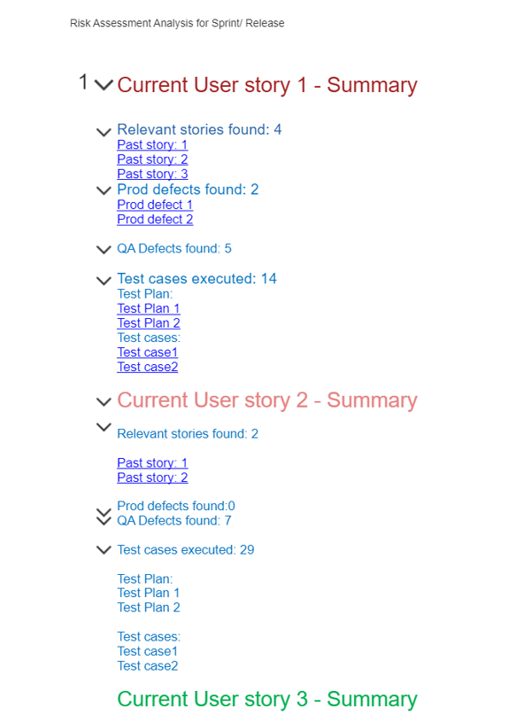

Slide 6
Benefits
More relevant story points can be provided based on the data.
Improve communication among team members
Minimizes chances of prod defects
Helps in providing more insights to the new stories
Improves sprint outcomes, reduces risks, and maximizes resource efficiency

